Slide 1
Strategic Planning and Implementation of Online Course Improvements at Scale
MDLA Spring 2023 Conference April 14, 2023
Adesola Ogundimu, Senior Instructional Designer
Charles Wachira, Senior Director
Jun Fang, Assistant Director for Instructional Design & Technology
Teaching & Learning@Carey

Slide 2
We'd like to know a bit about you:
(1)Tell us the name of your institution.
(2) Describe your role.
ⓘ Start presenting to display the poll results on this slide.

Slide 3
Session Objectives
Establish the value of maintaining and improving online course quality through holistic course improvements.
Highlight a scalable framework for planning and managing online course improvements (revamps).
Guide attendees' reflection on online course improvement resources and processes at their institutions.

Slide 4
Agenda
Background: Online Course Quality
Factors and approaches for maintaining quality
Framework
Lessons Learned

Slide 5
Overview: Teaching & Learning@Carey
We strive to promote teaching excellence at Johns Hopkins Carey Business School by working closely with faculty to support student learning.
Teaching & Learning@Carey helps faculty to identify strengths and challenges in their teaching practice by analyzing information collected from various sources including, but not limited to, students, faculty, staff, observations, and relevant research.
We work closely with faculty to integrate innovative technologies and pedagogical strategies to provide effective teaching and, in turn, to increase the quality of student learning at the Johns Hopkins Carey Business School.

Slide 6
Services
Teaching & Learning@Carey
Faculty development
Instructional technology training & support
Instructional design
Learning assessment
Media Production
Various Learning Modalities (Online, Onsite/In-person, Hybrid, Remote-Live)

Slide 7
Online Courses at the Carey Business School
112 Online Faculty.
The first online course was developed and launched in FA II 2014.
Offered in an online asynchronous modality.
Modular structure: 8 modules of content, readings, instructional media (video and interactive media), assignments and activities.
100+ Online Courses.

Slide 8
Quality in Online Courses
Several factors impact quality for online courses. According to Quality Matters (QM) they include:
Course Design
Course Delivery
Course Content
Institutional Infrastructure
Learning Management System (LMS)
Faculty Readiness
Student Readiness

Slide 9
A Moving Target: Maintaining Online Course Quality
Major Drivers:
Evolving discipline/subject domain.
Student needs and feedback.
Program curricular changes.

Slide 10
Other Factors and Trends
Digital accessibility.
Advances in information technologies:
Artificial intelligence (ChatGPT) – AI literacy and other new literacies.
Impacts of the pandemic, geo-political issues and global economic shifts:
Skills-based learning
Micro credentials
Limited instructional design capacity.
2022 EDUCAUSE Horizon Report, Teaching and Learning Edition

Slide 11
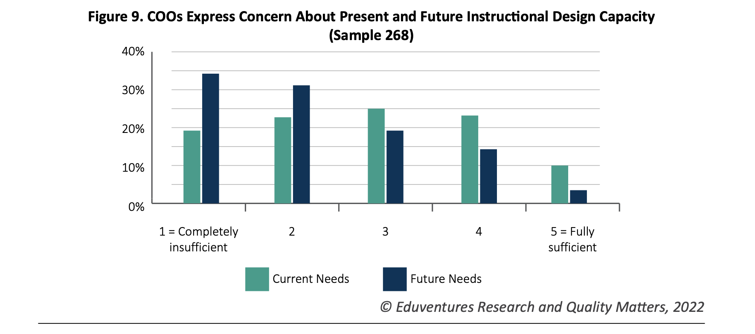
Changing Landscape of Online Education (CHLOE 7) survey report: Tracking Online Learning from Mainstream Acceptance to Universal Adoption

Slide 12
Which of these factors drive the need for major online course updates at your institution?​
ⓘ Start presenting to display the poll results on this slide.

Slide 13
Traditional Approach: Routine Course Revisions
PURPOSE: Addressing critical elements and maintaining efficiency
INTEGRATION: Overall course design? Evolution as individual components are revised
INTEGRATION: Addressing (program-driven) curricular changes
TIMING: To minimize disruptions and dependent on faculty/ID availability
Timely revisions/patches.
As needed (prior to or at the end of each offering).
Incremental updates to select course components.
Fixes to broken links, media and course tools.
Updates to readings.

Slide 14
Course Revamps:
Holistic course improvements.
Timing: Scheduled.
Dedicated resources: Design team and faculty commitment.
Goal:
Purposeful and targeted towards improving the course as a whole to address necessary curricular changes guided by instructional design principles.
Scope:
Guided by a comprehensive review of the online course (objectives, structure, content, technology and delivery).

Slide 15
A Framework for Continuous Online Course Improvement
Systematic and scalable:
Scheduled and tiered based on:
Resource availability.
Faculty availability and schedule.
Course shelf life (typically ranges from 2 – 5 years).
Program needs.
Assignments (redesign/updates)
Multimedia edits
Tier 2: Refresh (moderate changes to the original course – 8 weeks)
Tier 3: Redevelopment (major changes to the original course – 12 weeks)
Supplemental resources
Tier 1: Edit (small changes to the original course – 4 weeks)
Tier 2 improvements
Some module learning objective revisions
Tier 1 improvements (with some new multimedia)
Extensive module learning objective revisions
Additional multimedia development
Professional video
Graphic design
Interactive media

Slide 16
Example Revamp Course Plan
Course | Course Shelf Life | Revamp Category
Business Communication | 4 years | Tier 3: Redevelopment
Business Law | 3 years | Tier 2: Refresh
Corporate Finance | 2 years | Tier 2: Refresh
Corporate Strategy | 2 years | Tier 2: Refresh
U.S. Healthcare Systems | 2 years | Tier 1: Edit

Slide 17
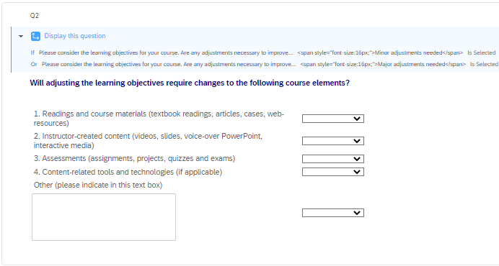
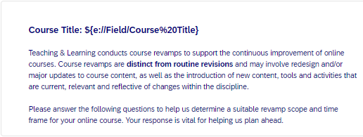
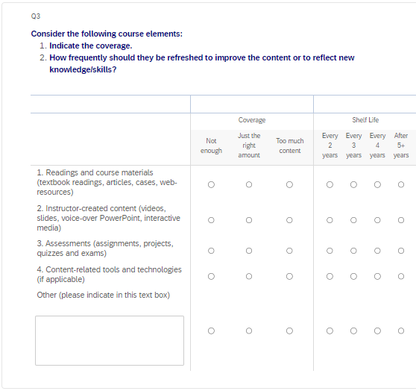
Planning Process
Course review.
Faculty survey:
Changes to the course learning objectives to reflect changing curriculum/domain.
Course shelf-life.
Multimedia content.
Interactivity.
Observations and feedback collected during delivery.

Slide 18
Revamp Process/Implementation
Faculty commitment and agreements.
Mirrors the instructional design process.
Provides an opportunity to update course technology and accessibility to meet new institutional requirements.

Slide 19
Stakeholders
Online Oversight Group (Faculty leadership governance body).
Online Course Lead (Faculty).
Other faculty teaching the online course sections.
Design team (Project Manager, Instructional Designer, Media Producer).
Project team (Instructional Technologists, Multimedia artists, Copyeditor).

Slide 20
Tier 3: Redevelopment (12 weeks)

Slide 21
Steps | Timeline | Owner | Outputs
Pre-kickoff Faculty developer and T&L review the purpose, general process, and financial agreements for the revamp project. | N/A | Faculty Developer, T&L Sr. Director, Asst. Dir. for IDT | Confirm revamp category Identify faculty Availability Assign Instructional Designer (ID)
Kick-off Instructional Designer works with faculty on information collection, revamp objectives, timeline, and deliverables. | Week 1 (official Start) | Faculty developer, ID | Decide specific objectives, timeline and deliverables Decide communication channels
Course Blueprint Review/Development Instructional works with faculty on course blueprint document. | Week 2 | Faculty developer, ID | Revised course blueprint
Media Plan (1st or 2nd milestone) Instructional Designer works with faculty on media plan; review media plan. | Week 3 or 4 | Faculty developer, ID, Multimedia Producer | Media plan Content Schedule
Content Milestones Instructional Designer works with faculty on specific deliverables. | Week 4 – Week 8 | Faculty developer, ID | Content deliverables Redesign project track sheet
Content Edit ID and Multimedia team will work on the content redesign and updates, including multimedia production. | Week 9 – Week 10 | ID, LT, Multimedia team | Course content redesign in LMS Completed New multimedia
QA Faculty developer, ID work on the QA process . | Week 11 | Faculty developer, ID, LT | Finalized course content, including multimedia Completed QA checklist
Revamp Approval Instructional Designer submits the completion notice to T&L Sr. Director for approval. | Week 12 | ID, T&L Sr. Director | Revamped online course template Completed revamp track sheet Approval from Sr. T&L Director

Slide 22
Impact
Faculty and student feedback.
Culture of continuous improvement.
Course shelf-life management.
Challenges:
Re-evaluating Tier 1 revamps.
Escalations.
Inclusivity: Incorporating perspectives from other course section instructors.
Faculty transitions.
"Student feedback on the new group project was very positive in the Consumer Behavior course. Students appreciated the structure and freedom to choose from multiple topics. The group project provided a construct to apply the course concepts and allow students to insert their own experiences - since they are all consumers..."
"I felt the assignments were challenging, relevant and helped students master the intended content..."
"The course content was reflective and helped me understand my own behaviors..."

Slide 23
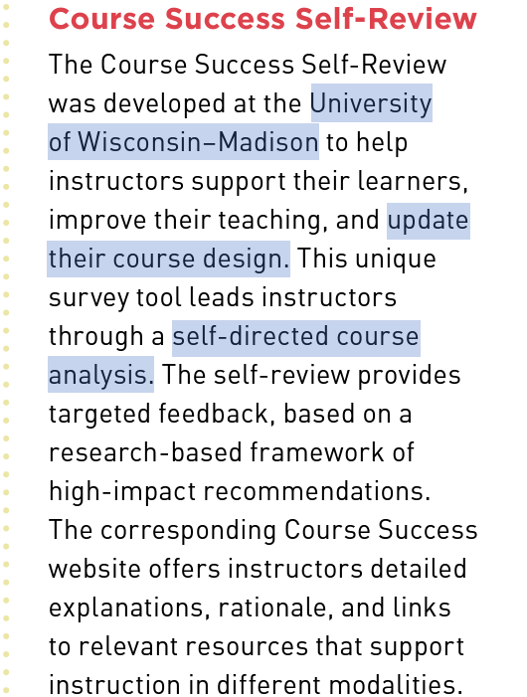
Other Approaches
2022 EDUCAUSE Horizon Report, Teaching and Learning Edition

Slide 24
References
EDUCAUSE (2022). 2022 EDUCAUSE Horizon Report, Teaching and Learning Edition. Retrieved from: https://library.educause.edu/resources/2022/4/2022-educause-horizon-report-teaching-and-learning-edition
Garrett, R., Simunich, B., Legon, R., & Fredericksen, E. E. (2022). CHLOE 7: Tracking Online Learning from Mainstream Acceptance to Universal Adoption, The Changing Landscape of Online Education, 2022. Retrieved from the Quality Matters website: https://www.qualitymatters.org/qa-resources/resourcecenter/articles-resources/CHLOE-project
Quality Matters (2023). Why Quality Matters: Process. Retrieved from the Quality Matters website: https://www.qualitymatters.org/index.php/why-quality-matters/process
Swaak, T. (August, 2022). Online Education Is Booming, but Colleges Risk Lapses in Quality, Report Says. The Chronicle of Higher Education.
University of Wisconsin–Madison. Course Success Self-Review.

Slide 25
Build for what’s next™

