Slide 1
Sharing Policy
CC BY-NC-SA 4.0 Under the following terms:
BY – Attribution – You must give appropriate credit, provide a link to the license, and indicate if changes were made. You may do so in any reasonable manner, but not in any way that suggests the licensor endorses you or your use.
NC – Non-Commercial – You may not use the material for commercial purposes.
SA – Share Alike – If you remix, transform, or build upon the material, you must distribute your contributions under the same license as the original.
No additional restrictions — You may not apply legal terms or technological measures that legally restrict others from doing anything the license permits.
Notes:
Reference handout.

Slide 2
Generative AI in Education
Exploring Instructional and Learning Partnerships
Joseph Rafter
Notes:
Abstract minimalist cover slide - flipped

Slide 3
Joseph Rafter
Instructional and Technical Designer, MACEM & PS at
Frederick Community College
linktr.ee/josephrafter
Notes:
Single presenter intro

Slide 4
Let’s Set Our Feet

Slide 5
“
What can we ask students to do that they couldn’t do before?
Ruben Puentedura, Inventor of the SAMR model
”
Notes:
Inspirational quote slide

Slide 6
Agenda
Shared Understanding
Liabilities
Academic Integrity
Capabilities
Educational Opportunities
Resources
04/14/23
Notes:
Agenda / table of contents slide

Slide 7
Shared Understandings . Learning, Teaching, and Assessing
01
Notes:
Short section title, or….

Slide 8
Learning, Teaching, Assessing
Create
Evaluate
Four Types of Knowledge
Factual
Conceptual
Procedural
Metacognitive
Analyze
Apply
Understand
Discernment
Vanderbilt University | Center for Teaching | Blooms Taxonomy
Anderson, L. W., Krathwohl, D. R., Bloom, B. S., & Bloom, B. S. (Benjamin S. (2001). A taxonomy for learning, teaching, and assessing : a revision of Bloom’s taxonomy of educational objectives / editors, Lorin W. Anderson, David Krathwohl ; contributors, Peter W. Airasian ... [et al.]. (Complete ed.). Longman.
Remember
Notes:
Reference the Revised Bloom Handout

Slide 9
What Do Your Students Do?
Part 1:
What in your practice fits into the “REMEMBER, UNDERSTAND, and APPLY” categories?
Part 2:
Estimate the percentage of time focused on these activities and assessments.
Notes:
4

Slide 10
What Do Your Students Do?
Part 1:
What in your practice fits into the “CREATE, EVALUATE, and ANALYZE” categories?
Part 2:
What activities and assessments would you like to include in your practice?
Notes:
4

Slide 11
Shared Understandings . Large Language Models
01
Notes:
Short section title, or….

Slide 12
OpenAI’s ChatGPT
A human interface with GPT
2015
MySpace
Windows 1.0
Apple 2e
Explore ChatGPT
chat.openai.com/chat
Notes:
Reference handout.

Slide 13
Alphabet’s Google Bard
Why now?
2015
LaMDA
Ethics Model
Explore Google Bard
https://bard.google.com/
Notes:
Reference handout.

Slide 14
Large Language Models
Hundreds of millions of data points
Notes:
What produces this result? Dataset or the programming?

Slide 15
Large Language Models
The GPT
The LLM
Notes:
What produces this result? Dataset or the programming?

Slide 16
Large Language Models
Your prompt plus an algorithm
The magic answer
Notes:
What produces this result? Dataset or the programming?

Slide 17
Large Language Models
Notes:
What produces this result? Dataset or the programming?

Slide 18
Large Language Model AI
OpenAI GPT:
Microsoft's Bing ChatGPT for search engines
Jasper with writing editors for businesses
YouChat lists sources automatically.
Chatsonic accesses Google searches
Google Bard
Google’s own next-generation language and conversational model.
Perplexity AI
Cites the sources it is using
Replika
Autoregressive GPT, which means it learns from your previous prompts
Focus is on a meaningful conversation; it can use previous inputs about your life and essentially tailor itself according to you.
Notes:
All AI science has been around for decades. Language Generating AI has been around for decades. Lots of flavors.

Slide 19
Thoughts? Comments?

Slide 20
LLM AI Liabilities
03
Notes:
Short section title, or….

Slide 21
LLM AI Weaknesses
Understanding Context – One Size Fits All
Recognizing Intellectual Property
“Hallucinates” Facts
Common Sense Reasoning Errors
Reduced Human Interaction
Social and Emotional Bias
GPT-4 Technical Report
teachonline.ca “Ten Facts about ChatGPT”
Notes:
Ruben Puentedura, inventor of the SAMR model: in the future, we need to review the purpose of copyright and deemphasize the importance of ownership.

Slide 22
LLM AI is Biased
GPT-4 has various biases in its outputs that we have taken efforts to correct.
We aim to make GPT-4 have reasonable default behaviors that reflect a wide swath of users’ values.
Get public input on what those bounds should be.
Social and Emotional Bias
GPT-4 Technical Report
Notes:
Who defines reasonable? Are there prioritized user values? Who in the public is heard?

Slide 23
Large Language Models
Bias in the Data
Notes:
What produces this result? Dataset or the programming?

Slide 24
Large Language Models
Bias in the Code?
Bias in the Results?
Notes:
What produces this result? Dataset or the programming?

Slide 25
Large Language Models
Bias in the Code?
Bias in the Results?
Notes:
What produces this result? Dataset or the programming?

Slide 26
LLM AI is Unreliable
Great care should be taken when using language model outputs.
Avoid high-stakes uses altogether.
“Hallucinates”
Facts
GPT-4 Technical Report
Notes:
HIGH STAKES
References
Microsoft Bing Chat

Slide 27
LLM AI is Careless
The vast majority of LLM data was cut off in September 2021.
Does not learn from its experience
Learns from us.
Sometimes make simple reasoning errors.
Can be overly gullible in accepting obviously false statements from a user.
Common Sense Reasoning Errors
GPT-4 Technical Report
Notes:
Eventually 4.0 will have access to 500 times more data points. Almost 1 Trillion

Slide 28
LLM AI is Unaware
GPT-4 will manufacture sources.
LLM will use itself as data.
Recognizing Intellectual Property
Notes:
Eventually 4.0 will have access to 500 times more data points. Almost 1 Trillion

Slide 29
Academic Integrity
05
Notes:
Short section title, or….

Slide 30
Define Cheating
Pencil eraser
Calculator
Spell check
Internet databases
Google searches
Online tutors
Homework helpers.
Mathscan
Technology has always disrupted the status quo. Think of paper and the piano.

Slide 31
Define Plagiarism
PowerPoint themes
YouTube videos
Creative Commons
Grammarly
TikTok dances
Tweets without references
Technology has always disrupted the status quo. Think of paper and the piano.

Slide 32
Acceptable Uses? - Students
Student engineers one prompt for an AI and submits the response without revisions or edits.
Student engineers one prompt for an AI. Then partners with an AI to revise and edit before submission.
Student engineers multiple AI prompts and effectively synthesizes the responses. Then partners with an AI to revise and edit before submission.
Student composes the main ideas and engineers a prompt for an AI to generate a draft. Then partners with an AI to revise and edit before submission.
Student engineers multiple AI prompts and searches the internet. Collects only ideas, and then writes independently before submission.
Student writes without consulting an AI or the internet.

Slide 33
Acceptable Uses? - Professionals
Professional engineers one prompt for an AI and submits the response without revisions or edits.
Professional engineers one prompt for an AI. Then partners with an AI to revise and edit before submission.
Professional engineers multiple AI prompts and effectively synthesizes the responses. Then partners with an AI to revise and edit before submission.
Professional composes the main ideas and engineers a prompt for an AI to generate a draft. Then partners with an AI to revise and edit before submission.
Professional engineers multiple AI prompts and searches the internet. Collects only ideas, and then writes independently before submission.
Professional writes without consulting an AI or the internet.

Slide 34
USPTO
Public Views on Artificial Intelligence and Intellectual Property Policy
October 2020
Notes:
Agenda / table of contents slide

Slide 35
USPTO
Position
A key priority of the United States Patent and Trademark Office (USPTO) is to maintain United States leadership in innovation, especially in emerging technologies, including artificial intelligence (AI).
Notes:
Agenda / table of contents slide

Slide 36
USPTO
Current Work
June 2022
AI/ET Partnership
Brings stakeholders together
Explores the intersection of intellectual property and AI/ET.
Notes:
Agenda / table of contents slide

Slide 37
USPTO
Upcoming Event
APR 25, 2023 - ALEXANDRIA, VA
AI Inventorship Listening Session - East Coast
This USPTO AI/ET Partnership listening session is to seek stakeholder input on the current state of AI technologies and inventorship issues that may arise in view of the advancement of such technologies.
Notes:
Agenda / table of contents slide

Slide 38
Personal observations?

Slide 39
LLM AI Capabilities
04
Notes:
Short section title, or….

Slide 40
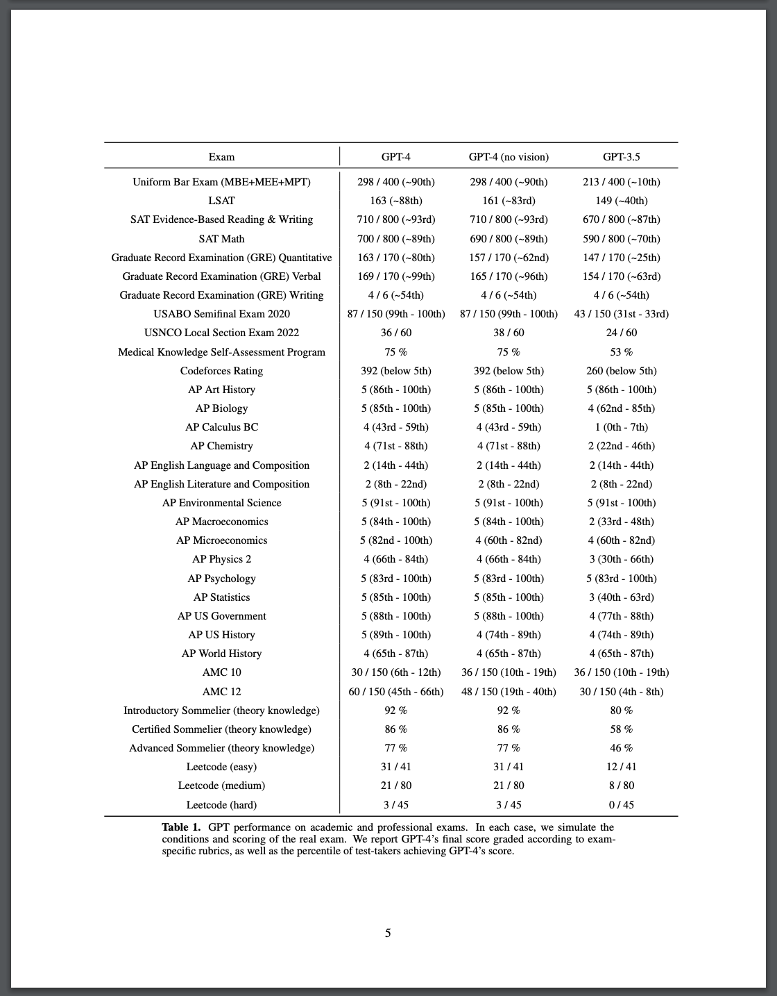
GPT-4 Technical Report
OpenAI published data that shows the significant increases in the tool’s capabilities.
Place your screenshot here
GPT-4 Technical Report

Slide 41
GPT-4 Technical Report
OpenAI published data that shows the significant increases in the tool’s capabilities.
Place your screenshot here
GPT-4 Technical Report

Slide 42
GPT-4 Technical Report
OpenAI published data that shows the significant increases in the tool’s capabilities.
Place your screenshot here
GPT-4 Technical Report

Slide 43
LLM AI Capabilities
Types of Knowledge
Factual
Conceptual
Procedural
Potential Weaknesses
Accuracy
Complex Explanations
Understanding Context
Apply
Understand
Remember

Slide 44
Strategies for Remembering, Understanding, and Applying
Policy. Work with leaders and colleagues to set equitable standards.
Clarity. Ensure your students understand your expectations and their responsibilities.
Prioritize. Decide the value and importance of the lower-order activities and assessments.
Explore. Consider the multitudes of brilliant strategies to make LG AI a learning partner.
Pause. Know that LG AI is not going anywhere. Pause and plan deliberately.

Slide 45
Thoughts? Concerns?

Slide 46
Educational Opportunities . And responsibilities
06
Notes:
Short section title, or….

Slide 47
LLM AI and Higher Order Learning
Create
Evaluate
Serious Risks
Understanding Context
Common Sense
Hidden Bias
Intentional Creativity
Complex Explanations
Analyze
Types of Knowledge
Metacognition
Notes:
Generative AI doesn’t like to get messy. Make mistakes, take risks, and try something new.

Slide 48
…REDUX
What Do Your Students Do?
Part 1:
Your activities and assessments that fit into the “CREATE, EVALUATE, and ANALYZE” categories.
Part 2:
Can ChatGPT support students in higher-order learning?
Can ChatGPT interfere with deep thinking?
Notes:
Use for longer narrative, particularly if you plan distributing this deck for review later.

Slide 49
Strategies for Analyzing, Evaluating, and Creating.
Experiment. Let teaching be messy.
Enrich. Let learning be messy.
Prioritize. Whenever possible, elevate learning above comparative grading.
Simplify. “This meeting could have been an email” = “This essay could have been a Flip video.”
Pause. Know that LG AI is not going anywhere. Pause and plan deliberately.

Slide 50
Current Realities of LLM AI in Education
Equitable Access
Critical Informational Literacy
Prompt Engineering
Professional Practices
Information Expansion
K-12 Initiatives

Slide 51
A Universal OER
Interactive Dialogue Partner
Future Uses of LLM AI in Education
Models of Thinking and Writing
Predictive Systemic Planning
Editing and Feedback Tool
Resource Creation

Slide 52
Resources
bit.ly/ClassroomAI
Notes:
Inspirational quote slide

