Slide 1
Ready, Set, Action!
Turn Your DEI Efforts into Action-based Practices
MDLA 2023
Presenters:
Shawn Crosby, Sr. Instructional Designer, CCBC
Eileen Hardin, Sr. Instructional Designer, CCBC
Kelly Stetka, Instructional Designer, CCBC

Slide 2
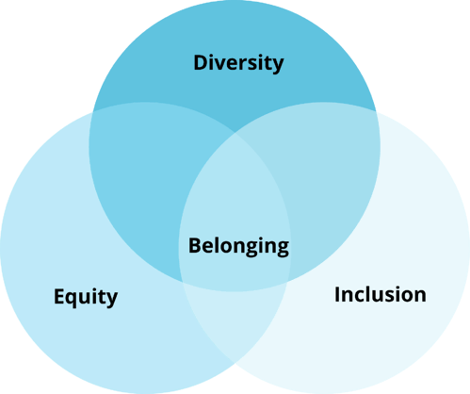
Introduction: What is deib?
Diversity: Recognizing and valuing our differences
Equity: Creating fair, individualized support and resources
Inclusion: Making sure that everyone has a seat at the table
Belonging: The key to true success
Source: Cengage
https://todayslearner.cengage.com/prioritizing-diversity-equity-inclusion-and-belonging-in-higher-education/
Notes:
Diversity: Including diverse content and voices provides a holistic view of your discipline.
Equity: Create fair access to the course content and use strategies that are suggested by universal classroom design.
Inclusion: Inclusive teaching strategies and classroom engagement techniques let students know their knowledge in ways that work for them, while also building connections.
Belonging: Foster a culture of belonging in the classroom. This could include challenging bias, addressing microaggressions, and encouraging civil discourse. Belonging is the center of these efforts.
“For students in two-year colleges, they may certainly face more structural barriers,” Brady said. “We know from other research that for students at two-year colleges they are often more likely to be balancing family and another job -- or possibly both. We know they can have greater challenges with access to needed financial aid. But it may be for many of those students the sort of relevant question is not ‘do I belong in this school?’ in general but possibly ‘do I belong in this major?’ or ‘do I belong in this class?’”

Slide 3
Communications
Build connections with students and keep them engaged
Create announcements to keep students up to date on course information
Post weekly reminders for upcoming due dates
Wrap up each week with a summary and highlights
Encourage students to set up LMS notifications
Notes:
What does the audience use?
Alternative Apps
WhatsApp
Remind
ClassPager
Teachers.io
Discord
Slack

Slide 4
Discussions/Course Introductions
Assign an Introductory Discussion during the first week of class
Invite everyone to contribute diverse opinions
Encourage students to share individual voices using video/audio options
Students gain a sense of community and belonging
Be sure that your course includes expectations for appropriate communication
Notes:
Online discussions can be less intimidating for students and consequently promote more active participation. Whereas in the classroom discussions may only involve a few students, in the online classroom each student has the opportunity to share their thoughts and opinions. Online discussions also allow students time to craft more thoughtful reflective responses before responding.
Share examples of community discussions.

Slide 5
Example: Introduction Discussion prompts
Example 1
Provide a short introduction about yourself and get to know others. Tell us about your major, background, interests, and any other things that you would like to share with us. What do you believe your communication strengths and weaknesses are, and what do you hope to gain from this course?
Example 2
Share a picture of your favorite place to study. Why is this where you do your best work?
Share 3 nouns and two verbs that best represent who you are. Explain why each one that you selected represents who you are.
Notes:
Ask audience to share.

Slide 6
Collaboration
Foster engagement among your students.
Assign group work to open students up to diverse thoughts and opinions.
Provide opportunities for students to work in breakout rooms.
Create discussion boards with assigned roles.
Use apps to gain participation.
Assign partners for peer feedback on assignments.
Encourage responses with audio and video tools.
Notes:
Ask audience for tools

Slide 7
Microcredentials-
Recognize achievements and completion by issuing badges and certificates to your students.
Makes course goals visible to students to help motivate them
Recognizes accomplishments
Demonstrates growth
All learners work towards common goals
Notes:
Ask the audience to share examples of badging in their courses
Mention Badger, Backpack, LinkedIn Portfolio?
Ask them to share experiences with microcredentialing

Slide 8
Checklists
Chunk larger assignments to help learners stay on track
Create a functioning to-do list
Promotes clear expectations
Encourages accountability
Promotes organization

Slide 9
Progress Monitoring
Monitor learner engagement and student success
Multiple progress indicators help you track:
Grades
Content access
Submissions
Login history

Slide 10
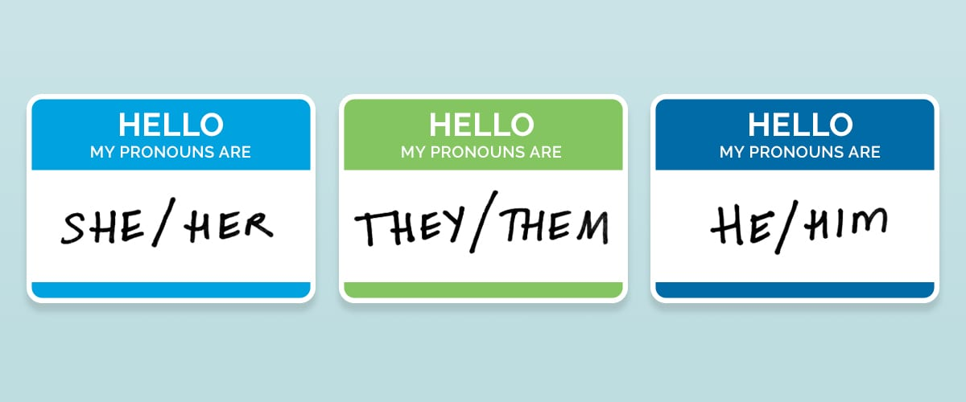
Pronouns
Promotes inclusion by respecting students' identities
Promotes a sense of belonging by creating a personal connection
Notes:
Respects student's identities
Creates a safe and inclusive environment
Survey
Introductions
Nametags
Email signatures
If enabled your LMS can display person pronouns

Slide 11
Audio/Visual Feedback
Record audio or video feedback for assignment submissions.
Creates a personal connection by personalizing feedback about student progress
Creates a more engaging way to provide feedback
Benefits student processing of feedback
Provides a sense of belonging
Notes:
3rd party tools
-Tools built into your LMS
Ask audience
Flip formally known as FlipGrid
GoReact
Screen Cast o Matic

Slide 12
Syllabus
Diversity and inclusion statement
Netiquette policy
Notes:
Syllabus statement-
How do you recognize and value diversity in your classroom?
Why is inclusivity important to you?
How can diversity be an asset for learning?
How will you handle issues related to diversity?
https://www.cmu.edu/teaching/designteach/syllabus/checklist/diversitystatement.html

Slide 13
Content
Lectures
Video
Websites
Articles
Case studies
Notes:
Ask audience what tools they use to deliver content
UDL
Multirepresentation – do your students see themselves reflected in the curriculum
Multiperspectives-
Active learning & Engagement

Slide 14
Assignments
Written
Audio
Video
Notes:
Offer student choice
Apps -
Ask audience -
Padlet
Flip
Jamboard

Slide 15
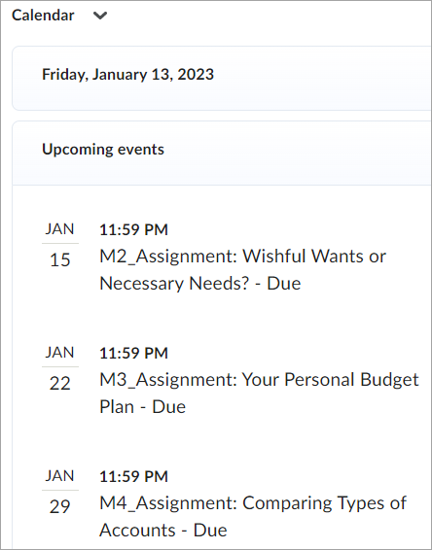
Course Calendar
Promotes time management
Sets expectations

Slide 16
Assessments
Late Submissions
Anonymous Grading
Rough Drafts
Practice Quizzes
Extended Time
Multiple Quiz Attempts
Notes:
Equity
Flexibility
Practice quizzes & multiple attempts-
Late submissions- Things happen – penalty or no penalty
Anonymous grading- avoid implicit bias
Rough drafts- refine thinking before final grade
Extended time-

Slide 17
Rubrics
Promotes fair, consistent grading
Can be associated with assignments and discussions
Customize levels, criteria, points, and feedback
Notes:
Share with students beforehand to set expectations

Slide 18
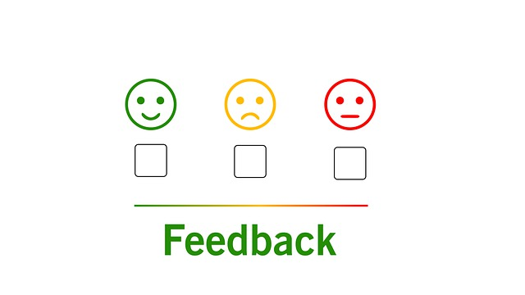
Student Check-ins
First Week
Weekly
Midsemester
Notes:
Polls
Surveys

Slide 19
Student Support
Ensure equal access to student support resources
Getting Started module with resources for:
Student success
Disability support services
Tech support
Library services
College and community outreach services
Notes:
Student success: tutoring, coaching, academic and transfer advisement, registration
College/community outreach: international students, veteran services, career services, food pantries

Slide 20
Taking Action
Notes:
Turn and Talk

Slide 21
Questions

